Slide 1
SWX Road to Continuous Delivery
Yovka Pencheva, SWX

Slide 2
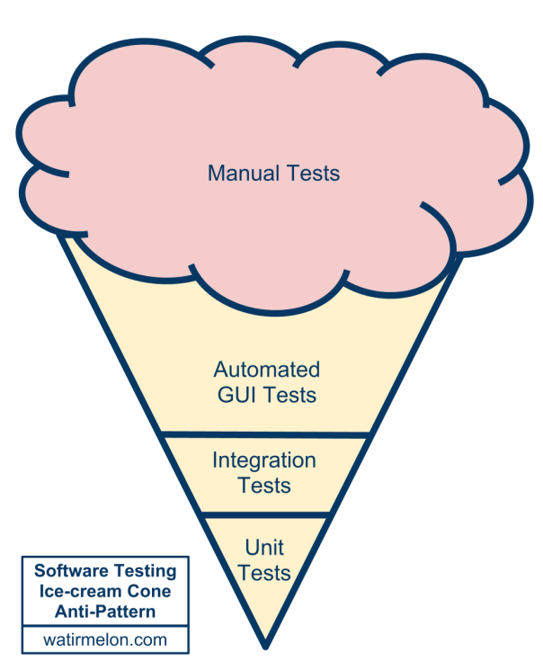
How we started – Ice-cream Anti-Pattern
A lot of manual RC testing before each release, test sign offs
Automated acceptance tests on UI level
Automated unit tests
Software testing ice-cream cone anti-pattern
Mini waterfall process, we could release max once per 3-4 weeks like that

Slide 3
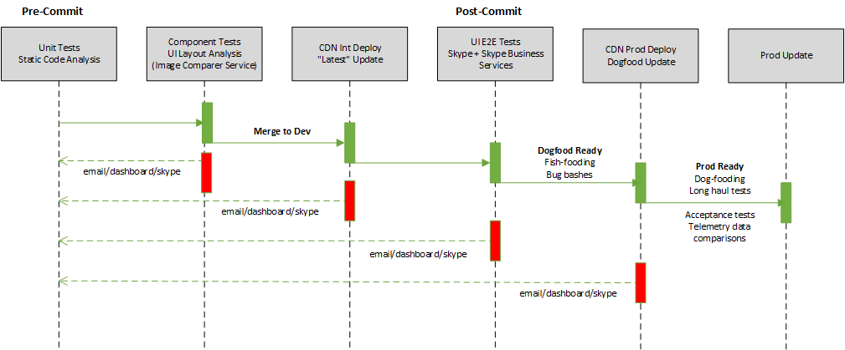
Continuous Delivery – Pipeline

Slide 4
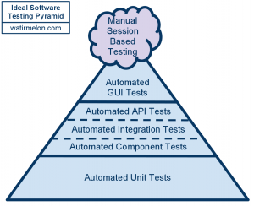
Continuous Delivery – Automation
No “silver bullet”
Push as much as possible automation coverage to the bottom (low test levels)
Analyze why regressions passed through automated net and “fix” the automation gap
Unit Tests
JavaScript tests, cover small units, all other units/interactions mocked
Run pre-commit
Component Tests
JavaScript tests, Gherkin-like DSL, run in PhantomJS, only HTTP/network communication is mocked
Run pre-commit
Screenshots Tests
Use DOM snapshots taken during component tests and apply CSS files to be committed
ImageComparer service – Selenium grid covering all supported OS/browsers – compares component tests snapshots to “golden” snapshot images
Run pre-commit
E2E Tests
UI (Selenium + SpecFlow) tests, Gherkin tests, ATTD/BDD tests
Run post-commit against test page, against Skype and Skype for Business backend services
Long Haul Tests
UI (Selenium + SpecFlow) tests , Gherkin tests
Run continuously against fully integrated products in DF env

Slide 5
Continuous Delivery in SWX
Fish-fooding
Each Dev commit deployed to CDN Int, immediately used by whole SWX org
Dog-fooding
Daily deployments to CDN Prod
Difference between Dogfood and Production is configuration setting, no rebuild, no redeploy
Testing in Dogfood environment (= Prod environment exposed to small number of users)
Whole team bug bashes in Dogfood environment
Long Haul tests in Dogfood environment
Telemetry analysis and comparison between Dogfood and Production tests
Production rollouts
In phases/rings - monitor telemetry to decide if to go ahead or rollback
Weekly rollouts to the world users

